Slide 1
Communications Workshop
2016 TWU LEGISLATIVE AND POLITICAL CONFERENCE
Ori Korin, Mary Matthews, Liz Doherty, Emma Chadband
#TWULegCon

Slide 2
“The two words ‘information’ and ‘communication’ are often used interchangeably. But they signify quite different things. Information is giving out, communication is getting through.” Sydney J. Harris, journalist
2016 TWU LEGISLATIVE AND POLITICAL CONFERENCE
#TWULegCon

Slide 3
GENERAL COMMUNICATIONS TIPS
Know your audience: Members? Elected officials and opinion leaders? General public? Opposition?
Know your medium: Is it a bulletin? A flier? An email? A newsletter article? A press release? A Facebook post? A Tweet?
Know your goal: Sharing critical info? Telling a story? Persuasion? Taking action? What are you trying to get people to do?
Know your materials: What needs to be produce to get the job done? What’s the timeline? Do you need things designed, printed, shipped or copied in order to engage with a group, track progress or measure success? Plan ahead! Think about deadlines, especially when you need help from another team or department.
Know your limits: Attention spans are short. A good message goes a long way. Test, experiment, and get feedback. Be transparent with your policies.
#TWULegCon

Slide 4
A NOTE ON STYLE
Consistency is key: We’re rebuilding the TWU brand and we need your help.
Moving forward, we’ll offer guidance on everything from:
How to use our logo
What words we officially capitalize
How to take your best photo
Titles, colors, and more
A good brand is consistent. It appears exactly the same for years, with minimal updates along the way.
#TWULegCon

Slide 5
COMMUNICATIONS STRATEGY
STRAGETY is the overall guidance behind the way we communicate and how we decide:
Which tools to use.
When we deploy them.
What messages we utilize.
Which spokespeople we engage.
Political campaigns, major corporations, and even other unions spend millions developing these strategies, using focus groups and other research to find out what works best and why.
We’re still in the infancy stages, but we’re making great progress—we’re growing our reach and our impact daily, and making huge strides in identifying who our people are, both in terms of members and allies.
#TWULegCon

Slide 6
COMMUNICATIONS STRATEGY
The International’s Communications Department is here to help with the strategy part:
Deciding which communications tool is the best for what you’re trying to achieve and,
What your strongest message and messenger might be.
This workshop will offer you some tips and resources so you and your members can utilize those tools more regularly!
Beyoncé sends a message at the VMAs. Strategic move? For sure.
#TWULegCon

Slide 7
COMMUNICATIONS TOOLS AND MATERIALS
Internal
Shop Talk
TWU Express
TWU clips
Fliers and bulletins
External
TWU Twitter, Facebook, and Instagram
TWU action alerts
TWU website
TWU videos
Campaign Communications
Media advisories and releases
Email campaigns, online actions, and petitions
Media interviews
LTEs, op-eds
#TWULegCon

Slide 8
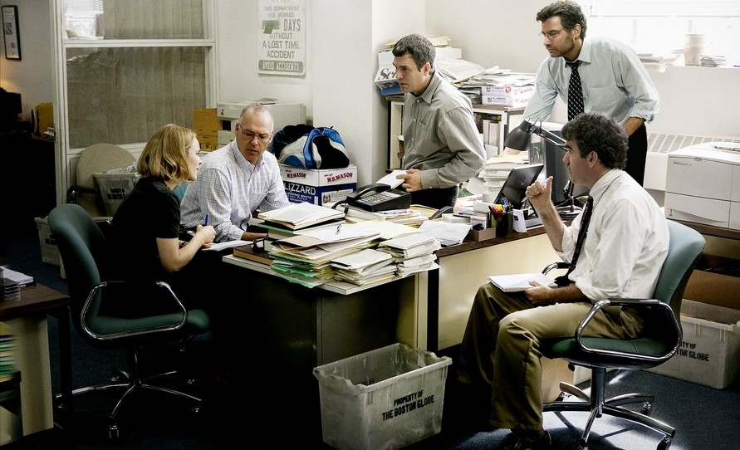
GETTING STARTED
No matter what you’re trying to write, be it a flier, a Facebook post, or a press release, always start with the same questions:
Who is my audience?
What do I want them to do or understand?
What’s my message?
The Boston Globe’s Spotlight Team, featured here in this year’s Academy Award™ Best Picture winner “Spotlight” asks these same questions when they write.
#TWULegCon

Slide 9
GETTING STARTED
Don’t be afraid to sit down and WRITE! Embrace it. Get your pen and paper out, or sit down at that blank screen and just type. Worry about the editing and the fine tuning later. Part of running strategic campaigns and winning them means doing what feels uncomfortable and hard: for many of us, that’s sitting down and putting words to screen/paper.
Practice training those muscles—start with bullet points and outlines if it’s easier.
#TWULegCon

Slide 10
OTHER TIPS TO GET STARTED
Make a word association tree.
Try slogans or messages.
Practice writing the headline you’d want to read.
Write opposites of what you’re trying to say and work backward.
#TWULegCon

Slide 11
WRITING TIPS
How to write an effective press release:
Write the headline and news story you’d want to read – check Media Releases section of TWU website for good examples.
Use your five W’s and the H.
Strong quotes reinforce your message.
#TWULegCon

Slide 12
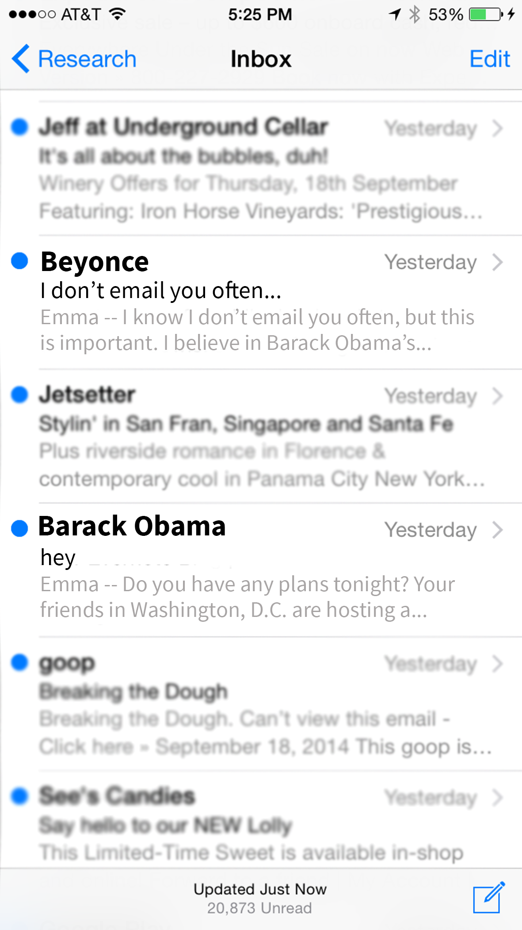
WRITING TIPS
How to write an effective email blast:
Subject lines are everything.
Always ask recipient to DO something…several times.
Short, personalized sentences that reiterate your message.
The Obama campaign wrote the book on email blasts, with some of the highest open rates in the biz.
#TWULegCon

Slide 13
WRITING TIPS
How to write an effective Tweet:
Be first, but be right—share the critical info.
Commentary is key—now is the time to be opinionated!
Embrace the tag—interaction!
This tweet was opinionated and used tagging effectively. It reached 130,000 people.
#TWULegCon

Slide 14
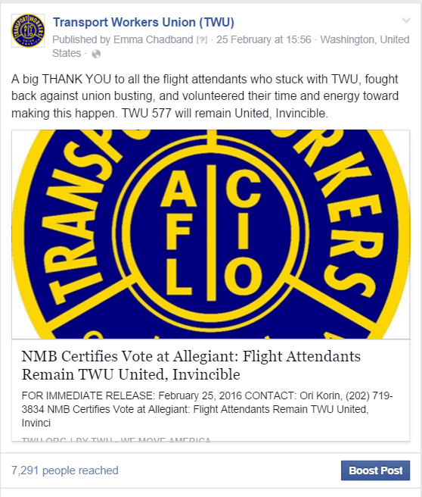
WRITING TIPS
How to write an effective Facebook post:
Take your Tweet, add a line or two.
Short, sweet and upbeat—here’s
where value statements are allowed!
Embrace the tag—interaction!
The more upbeat the tone, the more people we reach
#TWULegCon

Slide 15
WRITING TIPS
How to write an effective letter to the editor:
Know the outlet’s rules and guidelines—check length, local submission requirements, etc.
Bring the readers in at the outset—“I know we can all agree that X, Y and Z…”
Make your proposal—“And that’s why I urge X to stand with X and do X today, before it’s too late.”
#TWULegCon

Slide 16
WRITING TIPS
How to write an effective op-ed:
Tie it to something timely: A holiday? A current event? A piece of legislation?
Make your point early in the opening paragraph, then back it up with supporting evidence or examples in each paragraph afterward (be persuasive!)
Don’t be afraid to use member stories and voices.
#TWULegCon

Slide 17
WRITING TIPS
How to write an effective op-ed (cont.):
Opening paragraph: “This issue is critical for working people because of X.”
Supporting paragraphs: “It affects their X.” “It will have X impact on X major issue for our country.” “Here is X example from X of how this issue plays out.”
Conclusion: “We must take action on X today.”
#TWULegCon

Slide 18
RESOURCES
TWU and Labor-Specific:
Communications Organizing Toolkit
Friedrichs vs. CTA Toolkit (pre-Justice Scalia’s death)
JWJ Unions 101 and other 101s (good language to steal)
#TWULegCon

Slide 19
RESOURCES
General:
Purdue University’s Online Writing Lab (OWL) – Provides a library of articles and tips on every aspect of the writing process, organized by grammar topics, writing style and industry standards. Includes technical writing exercises to do from home.
Copywriting.com – Collection of resources specific to business/marketing.
DailyWritingTips.com – Straightforward, digestible list of technical tips; includes a business writing section.
#TWULegCon

Slide 20
RESOURCES
General (continued):
FreelanceFolder.com—Short list of simple but clever writing exercises.
Copyblogger—Offers an e-newsletter of business/marketing-specific writing tips.
The Book on Writing—Well-organized, thorough guide to writing with precision and clarity.
The Dictionary of Concise Writing—Provides concise alternatives to common, wordy phrases.
Strunk and White’s The Elements of Style—Standard grammar and punctuation guide, available for free online.
#TWULegCon

Slide 21
ISN’T COMMUNICATING FUN?
Questions?
communications@twu.org
#TWULegCon

